Slide 2
Session 1: Introduction
PROPOSAL WRITING CAMP

Slide 3
PROPOSAL WRITING CAMPS - THE PROCESS
Monday
Wednesday
Friday
  Horizon Europe Overview
  The Funding and Tenders Portal
  Call/topic decoding and understanding
  Proposal’s main parts
  Implementation
  Consortium as a whole
  Excellence
  Horizontal issues
  Budget
  Impact
  Specific Horizon Europe Programmes
  Possible actions to be proposed by the participant
  Final discussion

Slide 4
Agenda
Day 1
    Introduction & Overview
    Horizon Europe Overview and identification of relevant funding lines and thematic areas
    The Funding and Tenders Portal - How to find the right call (interactive)
    Evaluation criteria and evaluation summary reports and assessing proposal part
    Call/topic decoding and understanding (Group Work)
    Recap of Day 1 & outlook on Day 2 & 3
Notes:
Note: Adapt agenda to your specific PWC.

Slide 5
Agenda
Day 2
  Introduction to proposal’s main parts
  Implementation part overview
  Drafting a Work Plan description (Group work)
  Consortium as a whole
  Excellence part overview
  Drafting Excellence (Group work)
  Horizontal issues in Horizon Europe
  Identifying horizontal issues in the calls/topics addressed (Group work)
  Discussion, Q&A, Wrap-up of the two first days and orientations for Day 3

Slide 6
Agenda
Day 3
  Budget and eligible costs in Horizon Europe + Group Work
  Impact part overview
  Drafting an impact section (Group work)
  Presentation on specific Horizon Europe Programmes (e.g. MSCA, ERC, EIC)
  Identification of possible actions to be proposed by the participant’s organizations (interactive)
  Final discussion and Q&A
Notes:
Note: specify whether you will do a presentation on specific HEU programmes, and if yes which one(s).

Slide 7



HORIZON EUROPE – SHORT OVERVIEW
SPECIFIC PROGRAMME IMPLEMENTING HORIZON EUROPE & EIT*
Exclusive focus on civil applications
Pillar I
EXCELLENT SCIENCE
Pillar II
GLOBAL CHALLENGES & EUROPEAN INDUSTRIAL COMPETITIVENESS
Pillar III
INNOVATIVE EUROPE
European Research Council
Health
Culture, Creativity & Inclusive Society
Civil Security for Society
Digital, Industry & Space
Climate, Energy & Mobility
Food, Bioeconomy, Natural Resources, Agriculture & Environment
European Innovation Council
Marie Skłodowska-Curie
Clusters
European Innovation Ecosystems
Research Infrastructures
European Institute of Innovation & Technology*
Joint Research Centre
WIDENING PARTICIPATION AND STRENGTHENING THE EUROPEAN RESEARCH AREA
Widening participation & spreading excellence
Reforming & Enhancing the European R&I system

Slide 8

Our Vision
  The EU’s key funding programme for research and innovation:
  Tackles climate change
  Helps to achieve the UN’s Sustainable Development Goals
  Boosts the EU’s competitiveness and growth
  Facilitates collaboration and strengthens the impact of research and innovation in developing, supporting and implementing EU policies while tackling global challenges
  Supports the creation and better diffusion of excellent knowledge and technologies
  Creates jobs, fully engages the EU’s talent pool, boosts economic growth, promotes industrial competitiveness and optimises investment impact within a strengthened European Research Area.
Credits: https://www.un.org/sustainabledevelopment/sustainable-development-goals/

Slide 9
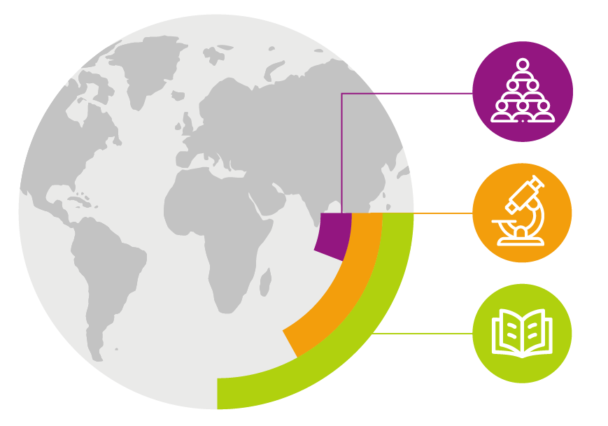
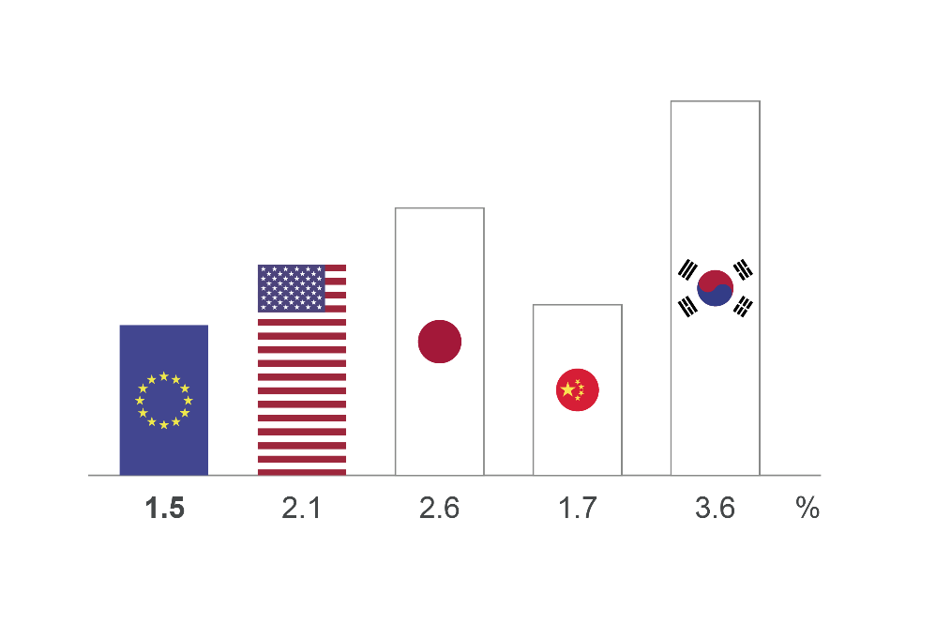
While benefiting from world-class research and strong industries… Our knowledge and skills are our main resources
6% of the world's
population
1.5% EU business R&D investment
17% of global R&D
25% of all high-quality scientific publications
EU figure is for 2019
Figures for USA, Japan, China and South Korea are for 2018. Figures represent R&D as % of GDP
…Europe can do better at transforming this into leadership in innovation and entrepreneurship

Slide 10
Horizon Europe Budget: €95.5 billion (2021-2027)
(including €5.4 billion from NGEU – Next Generation Europe – programme of EU for Recovery from COVID-19 crisis)
Political agreement December 2020
€ billion in current prices

Slide 11







Key Novelties in Horizon Europe
Lessons Learned
from Horizon 2020 Interim Evaluation
Support breakthrough innovation
European Innovation Council
Create more impact through mission-orientation and citizens' involvement
EU Missions
Rationalise partnerships’ landscape
New approach to partnerships
Reinforce openness
Open science policy
Strengthen international cooperation
Extended association possibilities
Encourage participation
Spreading Excellence

Slide 12
EU framework programmes proved powerful
for research & innovation impact
1.5 million
Collaborations from
more than
150 countries
3X
more often among top 1% cited publications compared to output in Member States
€48.2 million
Directed to coronavirus R&I just seven days
after the first
EU case reported
84%
of investments address Sustainable Development Goals; 30% address climate change
double
the proposals received per year compared
to the previous programme
19%
estimated labour productivity increase in funded companies thanks to the programme*
statistics from Horizon 2020 evaluation and monitoring and *Framework Programme 7 JRC research paper
Notes:
* from ‘The Impact of EU Grants for Research and Innovation on Private Firms’ Performance’ https://ec.europa.eu/research/participants/documents/downloadPublic?documentIds=080166e5c01f3e57&appId=PPGMS
Other statistics:
Horizon 2020 is a highly international and collaborative programme, creating vast networks across countries sectors and disciplines: participants from more than 150 countries take part in the programme and form more than 1.5 million collaborations worldwide;
Horizon 2020 is producing quality results with almost 100 000 EU-funded peer reviewed scientific publications cited more than twice the world average (Field-Weighted Citation Index of 2.3), and 3 times more represented in the world’s top 1% of cited research compared to publication output of EU Member States. 60% of these publications are available in open access enabling a wide diffusion of knowledge and solutions. Since 2009 the Framework Programmes generated more than 10 000 patents with a higher market value than the world average. Overall, 75% of all patents are owned by European entities, over half (52%) of which are SMEs. Most patents are in the areas of biotechnology, pharmaceuticals and organic chemistry.
Horizon 2020 is an attractive programme; the number of proposals received per year doubled compared to the previous Framework Programme. However since EU resources are limited Horizon 2020 has been able to provide funding for only one in eight proposals (success rate of 11.9%). Of every four proposals evaluated as being ‘of high quality’, three could not be funded.
Horizon 2020 is an efficient programme: As a result of simplification efforts grant agreements are now signed 1.7 times faster, taking an average of 184 days as against 313 under FP7. Overall, 89% of grant agreements are signed within the 245-day ‘time to grant’ target7.
Horizon 2020 is a Programme designed with an investment mind-set rather than as a ‘funding’ instrument. It is built to help the EU make the transition towards a sustainable and prosperous future. Horizon 2020 significantly contributes to the achievement of the United Nations Sustainable Development Goals (SDG), with up to 84% of the programme’s investments related to at least one SDG and, 30% of the programme’s investments related to climate action.
Horizon 2020 has shown a great level of flexibility and ability to act fast. The Programme is at the forefront of supporting research and innovation efforts, including preparedness for pandemics: €4.1 billion were invested from 2007 to 2019 on infectious diseases, including initiatives to address antimicrobial resistance, as well as preparedness and emergency response to outbreaks (Ebola, Zika)). On 31 January 2020, seven days after the first COVID-19 case in Europe, EUR 48.2 million were already mobilised through Horizon 2020 to support research on the new coronavirus. As of today, over a billion euros have been committed for this purpose. When research activities are of such a scale and complexity that no single Member State can provide the necessary financial or personnel resources alone, EU R&I programme helps sharing the risks and leveraging sufficiently large investments to generate a critical mass of money and talent to develop solutions, fast.
International cooperation in research and innovation has long been a strategic priority for the EU. With participants from more than 150 countries around the globe Horizon 2020 demonstrates a broad international outreach.

Slide 13



Horizon Europe
The ambitious EU research and innovation framework programme (2021-2027)
  fuel EU’s scientific and technological excellence and the strengthen the European Research Area (ERA)
  tackle policy priorities, including green and digital transitions and Sustainable Development Goals
  boost Europe's innovation uptake, competitiveness
  and jobs
Science
& technology
Society
Economy

Slide 14
Overview Funding lines & TRL
PROPOSAL WRITING CAMP

Slide 15
Types of Actions/ Projects in Horizon Europe
  Research and Innovation Action (RIA);
  Coordination and Support Action (CSA);
  Innovation Action (IA);
  Marie Sklodowska-Curie Actions (MSCA) - Staff Exchanges (SE), Co-funding of regional, national and international programmes (COFUND)
  EU Missions
  EU Partnerships
Modalities of the participation
Formal participation with Grant Agreement (GA)
Coordinator;
Partner
Associated party;
Third party.
Without Grant Agreement
Subcontractor
Collaborative projects
  European Research Council (ERC);
  Marie Sklodowska-Curie Actions (MSCA); Postdoctoral Fellowships.
Individual projects

Slide 16
Main type of Actions/ projects in Horizon EUROPE
Research and Innovation Actions (RIA) | =>What? Funding available for collaborative research projects tackling clearly defined challenges which can lead to the development of new knowledge or new technology. =>Who? Consortia of partners from different countries, industry and academia. Min. 3 legal entities established in 3 Member States or Associated Countries
Innovation Actions (IA) | =>What? Funding available for closer-to-the-market activities including prototyping, testing, demonstrating, piloting, scaling-up etc. for new or improved products, processes or services. =>Who? Consortia of partners from different countries, industry and academia. Min. 3 legal entities established in 3 Member States or Associated Countries
Business Plan (TRL higher than 6
Business Plan (TRL higher than 6/ if stated in the application form

Slide 17
Main types of Actions/ projects in Horizon Europe
Coordination and Support Action (CSA) | =>What? Funding available for actions consisting primarily of accompanying measures, such as the coordination and networking of research and innovation projects, programmes and policies (e.g. training, dissemination, exploitation, standardization, policy dialogues, etc.). Funding for research and innovation per se not covered. =>Who? Single entities or consortia of partners from different countries, industry and academia. Min. 1 legal entity established in 1 Member State or Associated Country

Slide 18
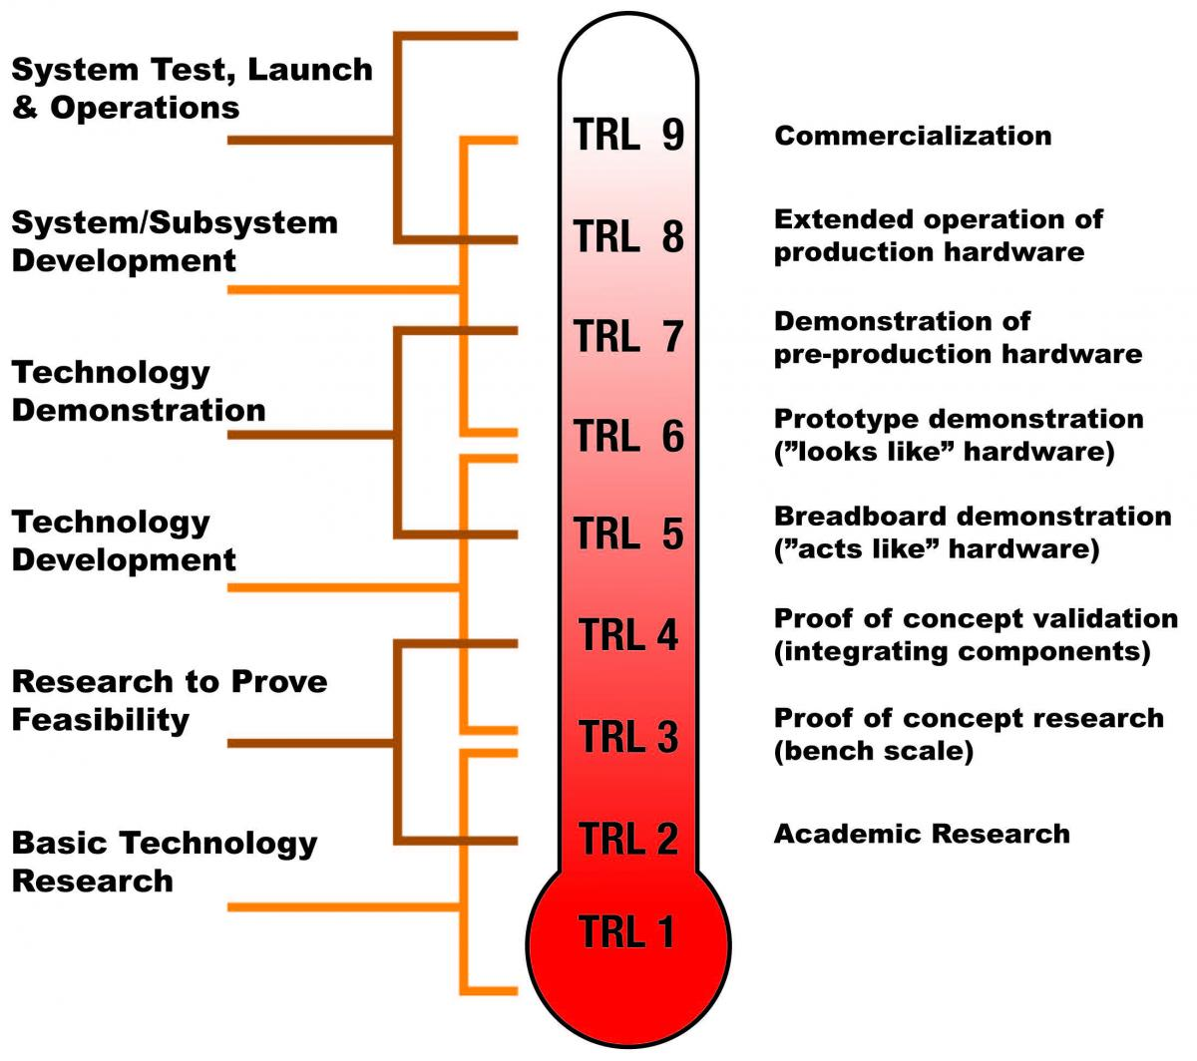
Technology Readiness Level
Technology Readiness Levels (TRLs) is used as a measurement of the maturity level of particular technologies in Horizon Europe.
Many of the call topics have a defined TRL at which the implementation of the proposal is intended to start, as well as a target TRL.

Slide 19
Technology Readiness Level
This measurement system provides a common understanding of technology status and addresses the entire innovation chain.
By evaluating a technology project against the parameters for each Technology Readiness Level one can assign a TRL rating to the project based on its stage of progress.
There are nine technology readiness levels; TRL 1 being the lowest and TRL 9 the highest.

Slide 20
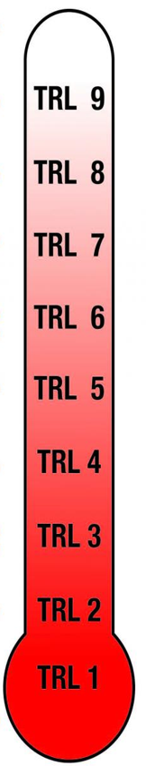
TRL and business plan
  The higher Technology Readiness Level (TRL) means a more business- oriented project. close-to-market activities (TRL 6 till TRL 9) => RIA (if higher than TLR6)
TRL 9: actual system proven in operational environment
Bussiness plan recommened in
RIA and IA in case the TLR > 6
TRL 8: system complete and qualified
TRL 7: system prototype demonstration in operational environment
TRL 6: technology demonstrated in relevant environment
TRL 5: technology validated in relevant environment
TRL 4: technology validated in lab
TRL 3: experimental proof of concept
TRL 2: technology concept formulated
TRL 1: basic principles observed

Slide 21
Contact us!
George Bonas
Daniele Gizzi
Global Service Facility of the EC

Slide 22
Thank you!
#HorizonEU
http://ec.europa.eu/horizon-europe

